Slide 1
Customer Churn Prediction by Jack

Slide 2
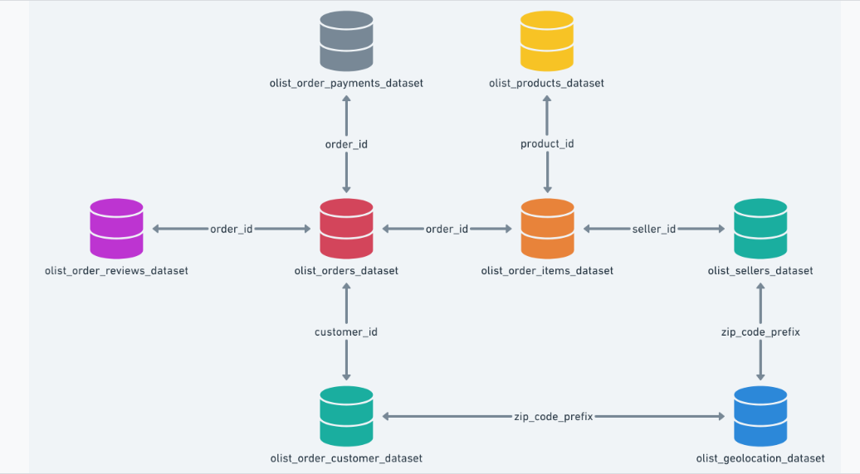
Dataset Overview
Data Source: Publicly available on Kaggle as the "Brazilian E‑Commerce Public Dataset by Olist"
Dataset Overview:
Obtained from Kaggle
Published Publicly by Braziliian Olist store
Contains 100k orders from 2016 to 2018
Contains interrelated 9 datasets and 43 distinct columns

Slide 3
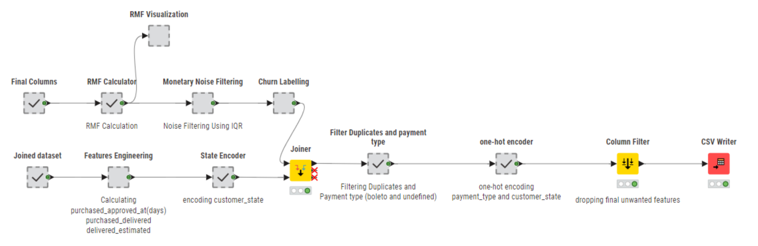
Dataset Preparation
Joined 4 datasets to get the required data columns.
Data cleaning,data transformation and feature engineering are all done in Knime.
Tableau is used to gain insights for related data columns.
Target variable (Churn) is calculated by Recency.
The Dataset is balanced. (churn: 54.7% and not-churn: 45.3%)

Slide 4
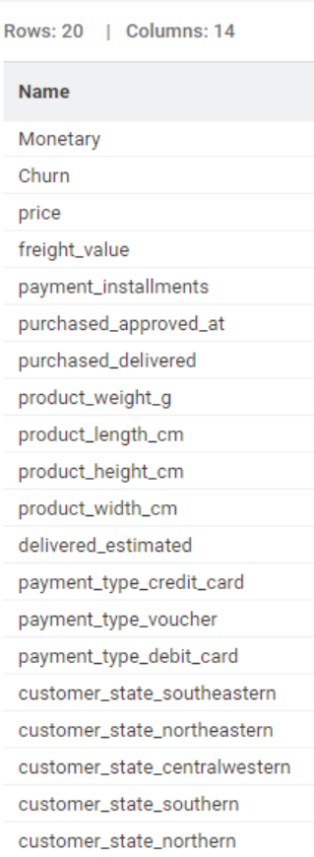
Dataset Preparation
Data Cleaning
Used nodes: row filter, duplicate row filters, rule engine and math column.
Removed duplicates, null values and noise values (using IQR).
Data transformation
Used nodes: one to many, string to date & time.
Data encoding and data type casting is done.
For example: one-hot encoding for customer_state, region encoding for state and payment_type, and correct the date & time data type columns.
Feature Engineering
Used node: date&time difference, rule engine.
Generated the new 3 features from existing features in order to align with model prediction.
Delivered_estimated, puchase_approve_at, and purchased_delivery.
Final_dataset contains: 19 features with 8 categorical and 11 numerical data.

Slide 5
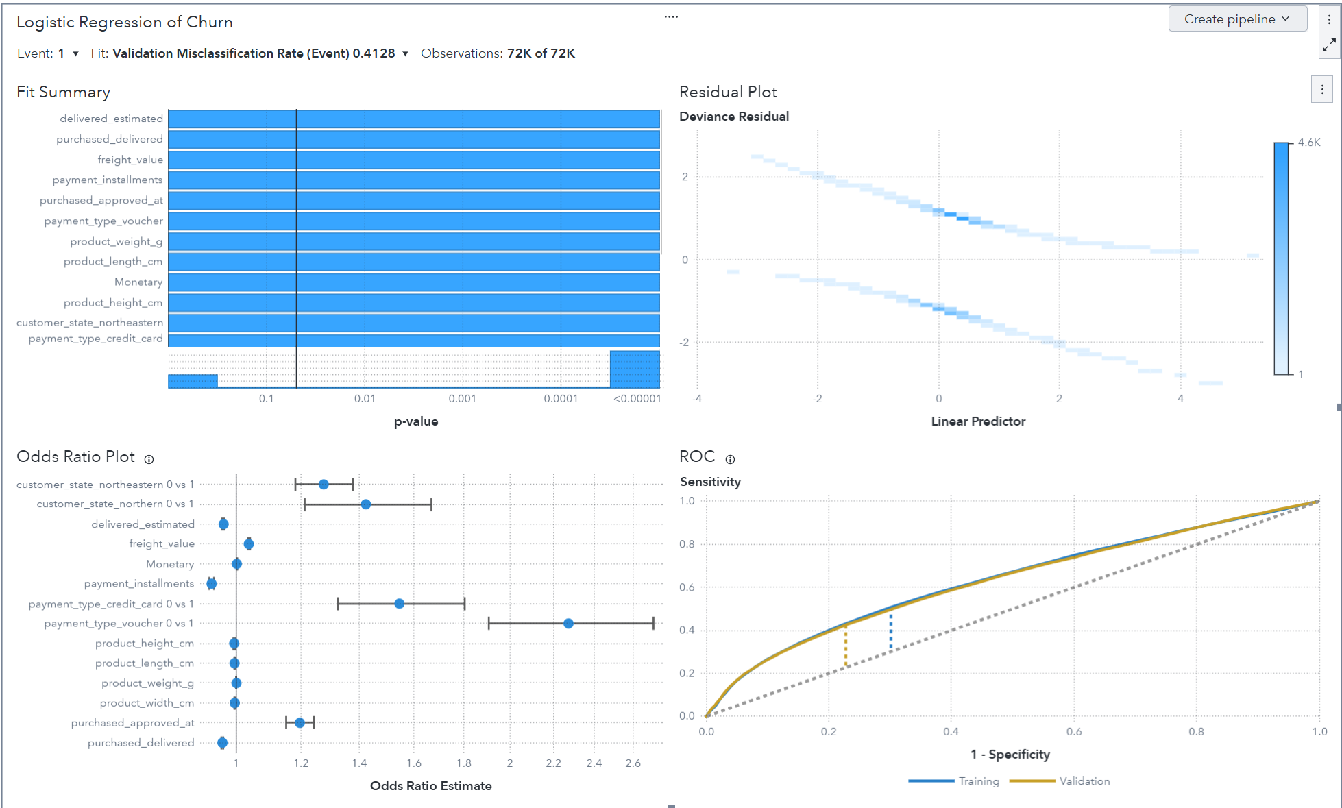
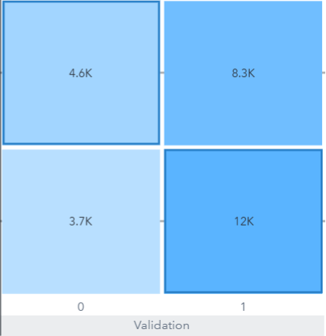
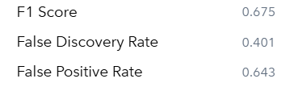
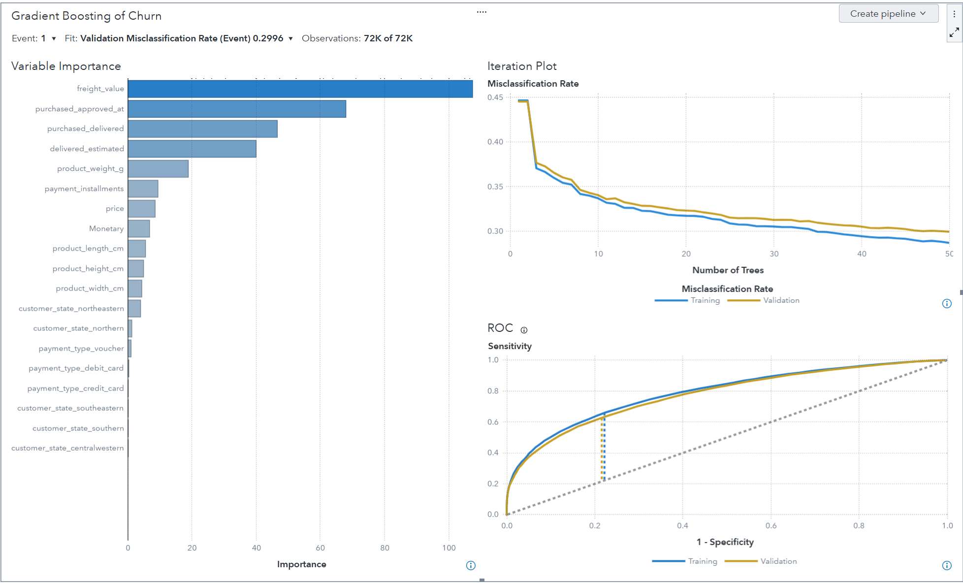
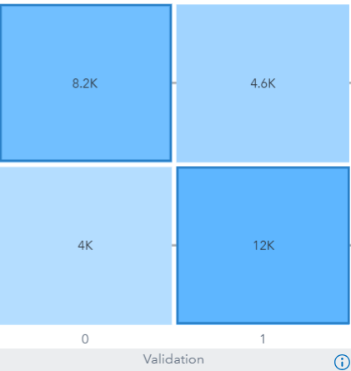
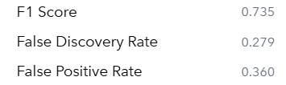
Modelling
Logistic Regression
Gradient Boosting

Slide 6
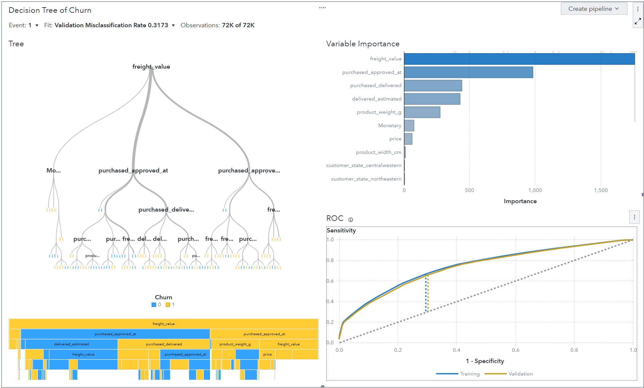
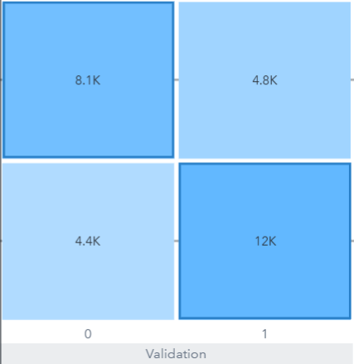
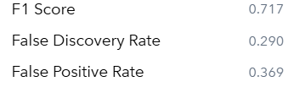
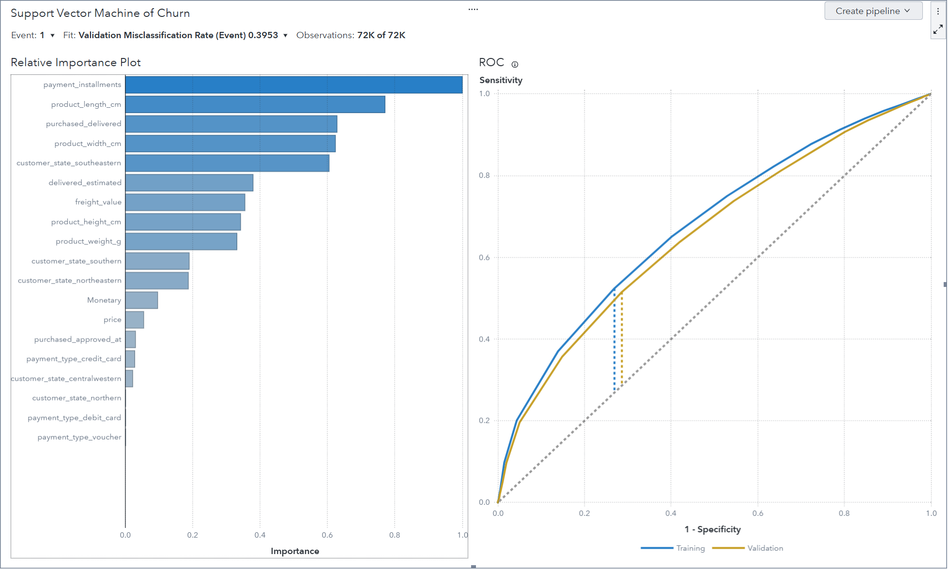
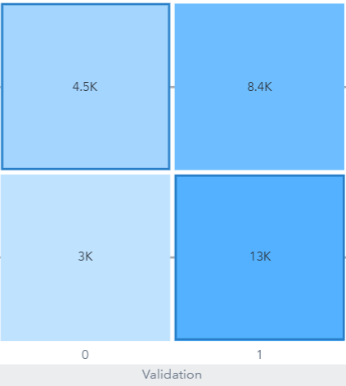
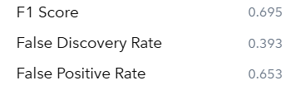
Modelling
Decision Tree
Support Vector Machine

Slide 7
Fine Tuning
Logistic Regression
Variable selection method: Forward Selection method with confidence of 0.95
Gradient Boosting
Maximum branches : 2 , Maximum depth: 5 and Leaf size: 5 (default)
Increasing max branches decrease the misclassification rate but overfitting occurs.
Support Vector Machine
Kernel function: Cuboid
Changing kernel function to cuboid gives lower misclassification rate and resolve overfitting problem from linear kernel function.
Decision Tree
Maximum branches : 3 , Maximum depth: 6 and Leaf size: 5

Slide 8
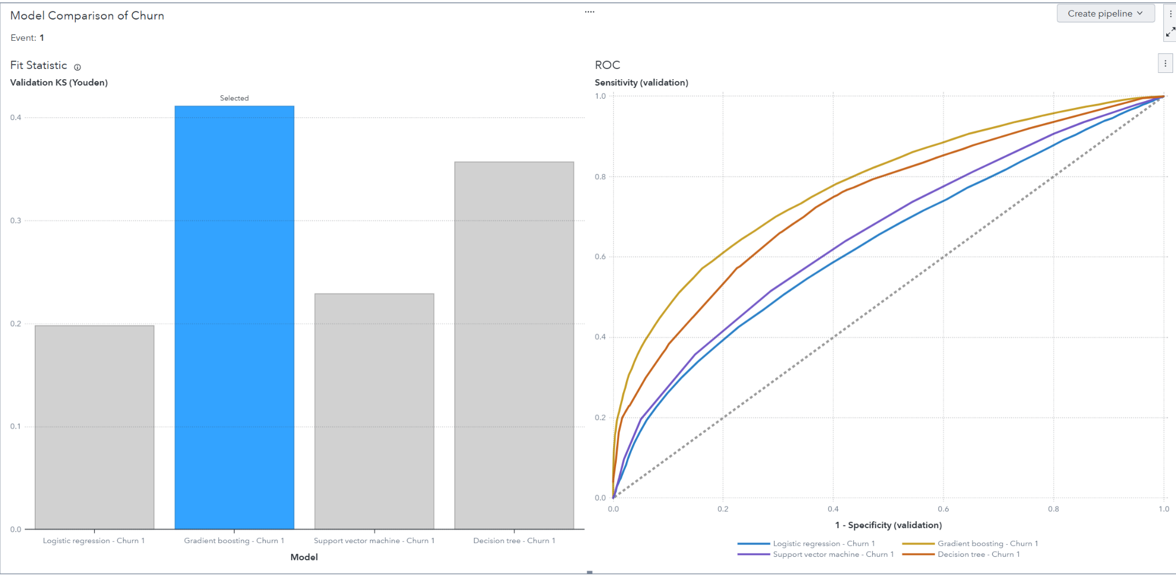
Evaluation and Model Comparison
Model Name | Accuracy | Precision | Recall | F1-score
Logistic Regression | 0.59 | 0.60 | 0.77 | 0.67
Gradient Boosting | 0.70 | 0.72 | 0.75 | 0.73
SVM | 0.61 | 0.61 | 0.81 | 0.69
Decision tree | 0.68 | 0.71 | 0.72 | 0.72
Model selection by Sas viya:
Gradient Boosting.
Model selection by metrics:
Gradient Boosting and
Decision Tree.

Slide 9
Conclusion and Recommendation
Across 4 models, freight value, delivery estimated, purchased approved duration and purchased delivered duration are important features.
Which is indicating customers were more likely to churn when they faced high shipping costs, long delivery estimates, delayed delivery performance.
These service-related features reflect how operational efficiency directly impacts customer loyalty.
Recommendations
Operational services like reducing freight value, tighten delivery timelines and automate purchase approvals can enhance customer lifetime value.
Overall, best optimal model: Gradient boosting
Model simplicity: Decision Tree

